Slide 1
BASIC ELECTRONICS
(24B11EC111)
Lecture-1

Slide 2


Slide 3


Slide 4


Slide 5
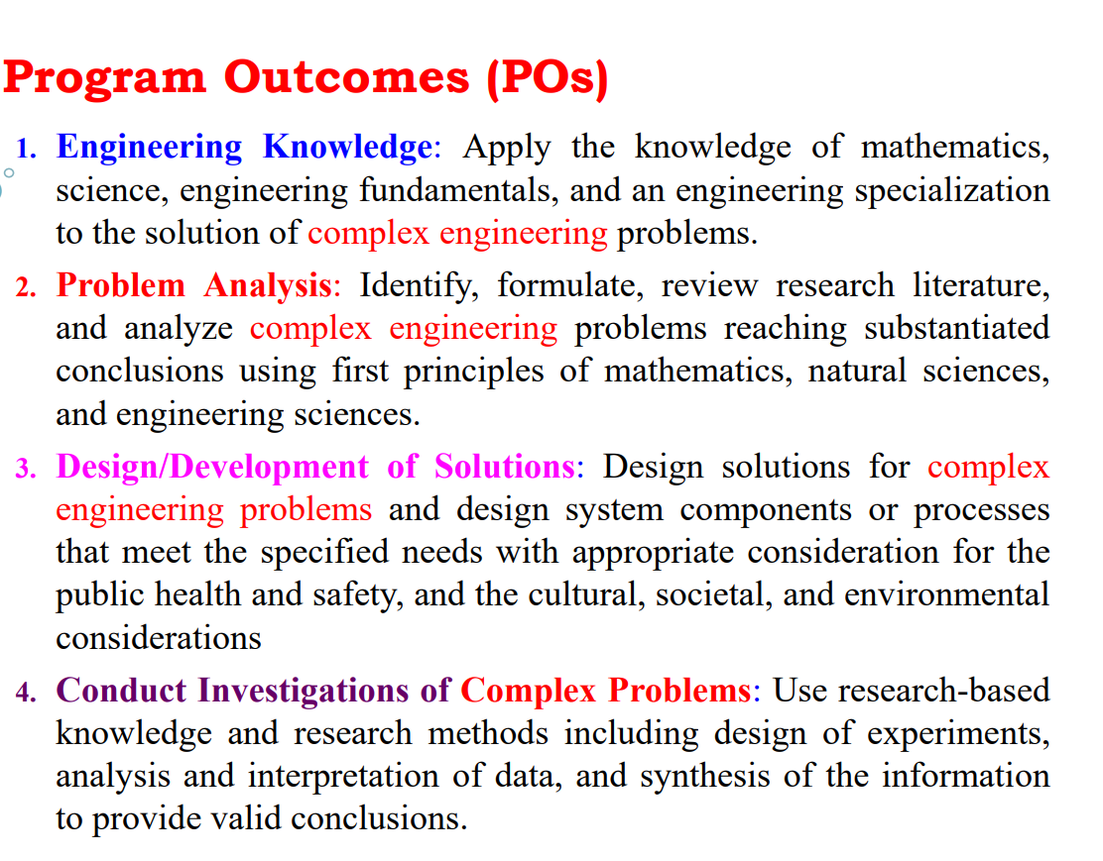

Slide 6


Slide 7


Slide 8
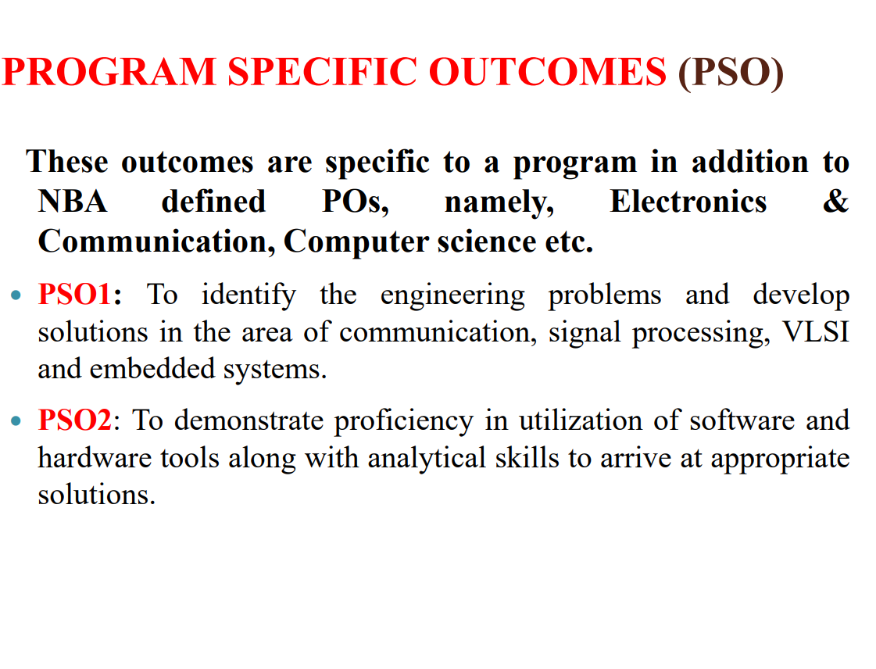

Slide 9
COURSE OUTCOMES (CO)
CO (Code: 24B11EC111) |  | COGNITIVE LEVELS
C.1 | Recall the concepts of various circuit elements and Kirchhoff’s laws. | Remembering Level (C1)
C.2 | Understand the basics of semiconductor PN junction diodes and Op-Amp, and their applications. | Understanding Level (C2)
C.3 | Apply network theorems to solve complex DC networks. | Applying Level (C3)
C.4. | Explain the operation of transistors (BJT and MOSFET) and analyze their biasing techniques. | Analyzing Level (C4)

Slide 10
SYLLABUS
Module No. | Title of Module | Topics in the Module | No. of Lectures
1 | Basic Circuit Analysis | Kirchhoff's Laws, Voltage Divider rule, Current Divider Rule, DC circuit analysis (Nodal, Mesh), Superposition and Thevenin/Norton Theorem | 10
2 | PN Junction Diode and Applications | PN Junction, Biasing the PN Junction, Current–Voltage Characteristics of a PN Junction, PN Junction Diodes, Half Wave Rectifier & Full Wave Rectifier Clipper & Clamping Circuits | 8
3 | Zener Diode and Applications | Zener Diode and applications, Line and Load Regulations of reference circuits. | 4
4 | Introduction to BJT | Introduction to BJT, operation, characteristics, Biasing and Stability | 6
5 | Introduction to MOSFET | Introduction to MOSFET, operation, characteristics and biasing | 6

Slide 11
SYLLABUS
Module No. | Title of Module | Topics in the Module | No. of Lectures
6 | Op-amp and Applications | Block Diagram Representation of Typical Op-Amp, Schematic Symbol, Op-Amp parameters, Ideal Op-Amp, Equivalent Circuit of Op-Amp, Op-Amp Applications: Inverting Configuration, Non-Inverting Configuration, Voltage Follower, summer, comparator, difference Amplifier, Integrator, Differentiator | 8
Total no. of lectures |  |  | 42

Slide 12
EVALUATION CRITERIA
Components Maximum Marks
T1 20
T2 20
End Term Examination 35
TA 25 (Assignements = 15, Attendance = 10 )
Total 100

Slide 13
RECOMMENDED BOOKS
R.C. Dorf and James A. Svoboda, “Introduction to Electric Circuits”, 9th ed, John Wiley & Sons, 2013.
Charles K. Alexander (Author), Matthew N.O Sadiku, “ Fundamentals of Electric Circuits”, 6th ed, Tata Mc Graw Hill, 2019.
Sze and Ng," Physics of Semiconductor Devices", 3rd Ed., 2006.
R. Boylestad and L. Nashelsky, ‘Electronic Devices and Circuit Theory’, PHI, 7e, 2001.
Ramakant A. Gayakwad, “Op-Amps and Linear Integrated Circuits”, 4th edition, Pearson, 2000.

